Slide 1
Skill Scarcity or Cost minimization?
The Debate Over H-1B Visas - 2011-2016

Slide 2
“The H-1B visa was established, as part of the Immigration Act of 1990, to let companies recruit trained foreign workers to work in “specialty occupations” for which there are few qualified local candidates.”
H-1B Visas

Slide 3
Background
Purpose: combat local labor shortages or skill gaps while maintaining global competitiveness
How it works:
Companies apply for H-1B visas for a specific role that will be paid at a salary on par with the “prevailing wage” for that type of role
H-1B job requires at least a bachelor’s degree or an equivalent amount of experience
Companies attest that they will not pay an H-1B worker less than they would an American
Every year there are 85,000 available visas which are distributed by a lottery system due to the high demand
Jobs tend to primarily be in science, engineering, information technology, medicine, and business

Slide 4
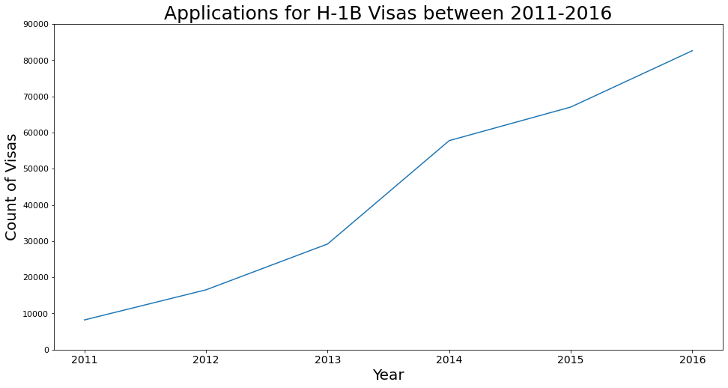
Applications continue to rise

Slide 5
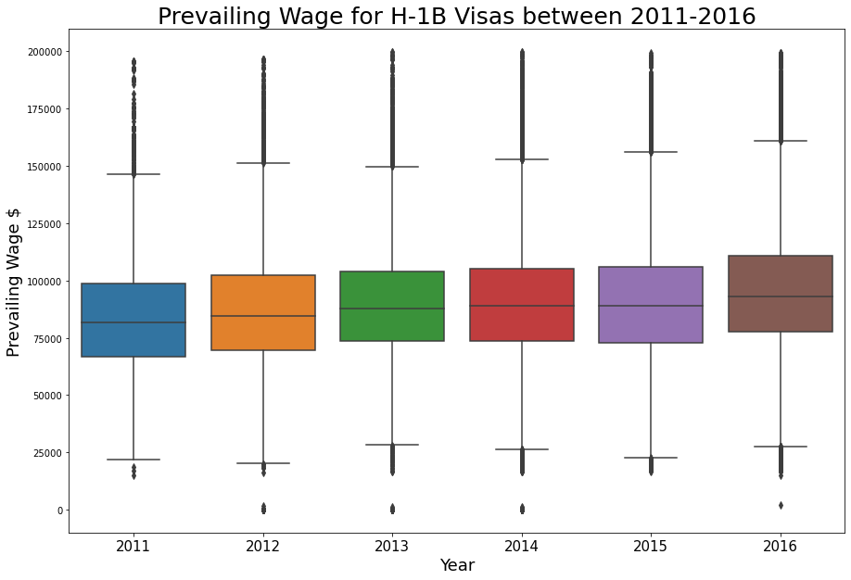
Wage Stagnation

Slide 6
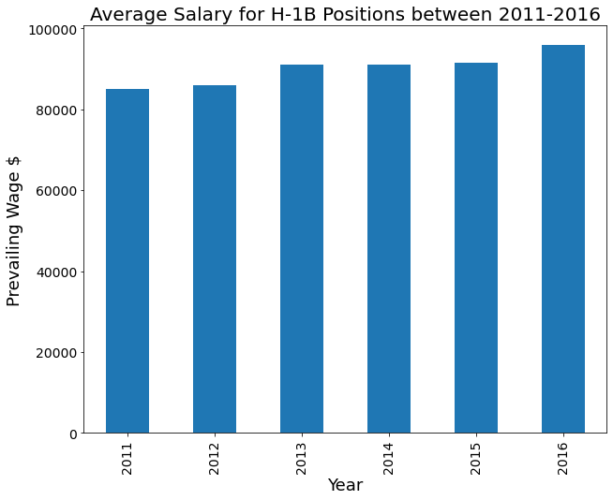
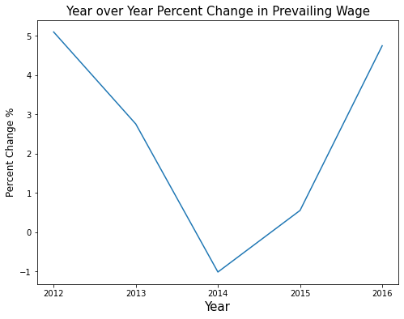
Year over year percent change <5%

Slide 7
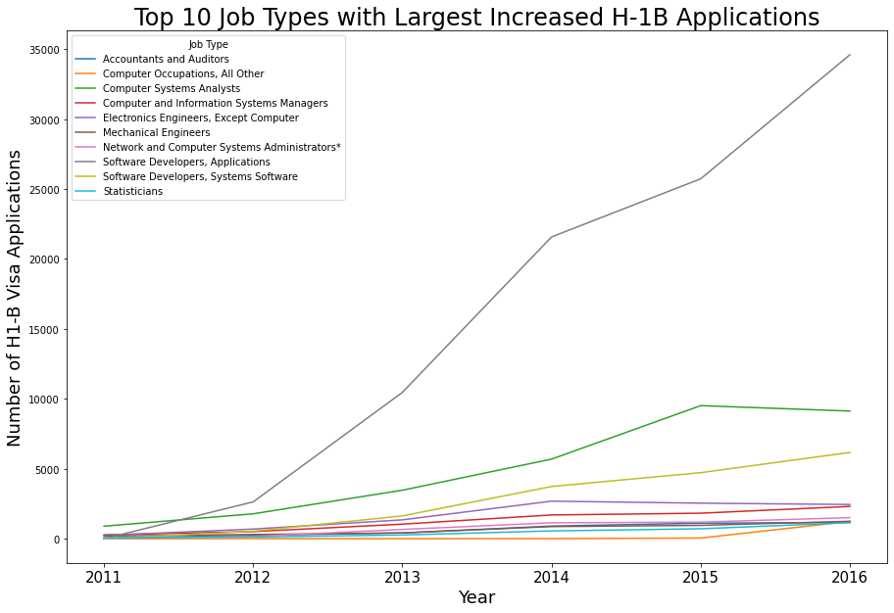
Job Category | Application Increase from 2011
Software Developers, Applications | 34,607
Computer Systems Analysts | 8,233
Software Developers, Systems Software | 6,167
Electronics Engineers, Except Computer | 2,210
Computer and Information Systems Managers | 2,033
Network and Computer Systems Administrators* | 1,505
Computer Occupations, All Other | 1,232
Accountants and Auditors | 1,133
Statisticians | 1,074
Mechanical Engineers | 1,053

Slide 8
“H-1B workers hold about 12%–13% of jobs in the tech industry while only holding around 0.6%–0.7% of U.S. jobs overall.” - Goldman Sachs

Slide 9
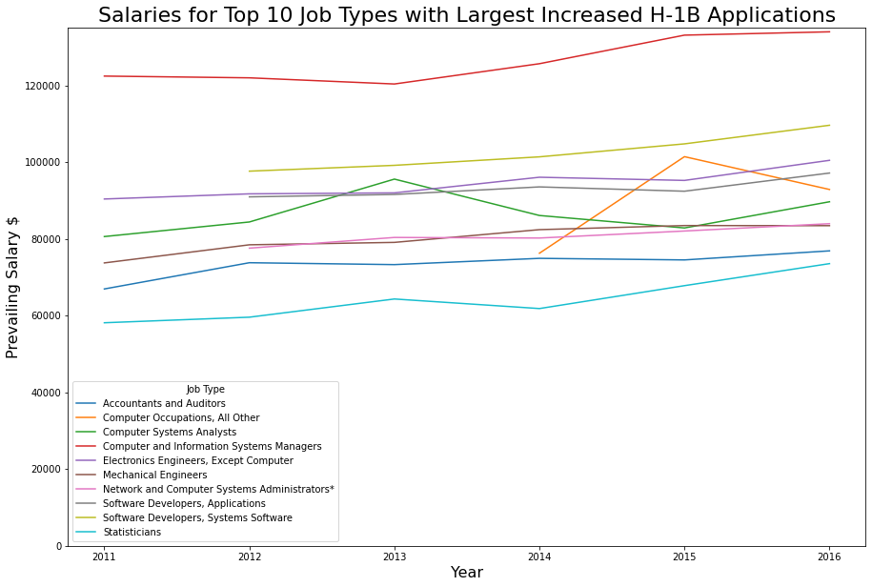
Salaries are relatively flat

Slide 10
The debate
Skill scarcity
Cost minimization
Program provides needed skills to the labor market to stay globally competitive
Number of unfilled US jobs in IT could be > 1M and American campuses produced fewer than 56,000 graduates with the sort of qualifications sought by information technology (IT) firms.
H-1B visa process is not inexpensive or easy
High skilled immigrants boost the economy by increasing innovation, productivity, and sometimes employment
H-1B visas allow companies to obtain “cheap” foreign labor to fill open positions due to shaky standards for determining prevailing wages
US graduates more STEM workers than the tech industry needs according to Rutgers
If there was a shortage of skilled workers than wages would surge for these roles (flat)
Adding additional workers to the system drives down wages for everyone (prevailing wage decreases)

Slide 11
Case Study
COGNIZANT TECHNOLOGY SOLUTIONS

Slide 12
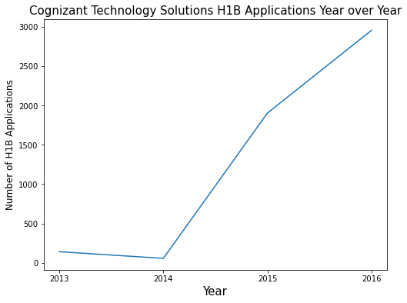
Job types for H1B Applications Computer Systems Analysts* Software Developers, Applications* Computer and Information Systems Managers Graphic Designers Sales Engineers *highest number of applications
2000%
in H1B Applications

Slide 13
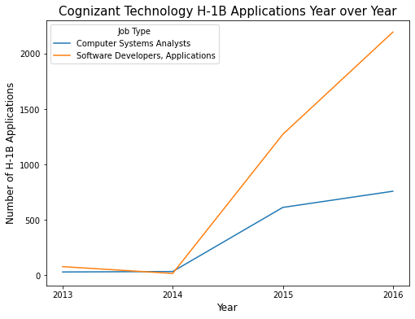
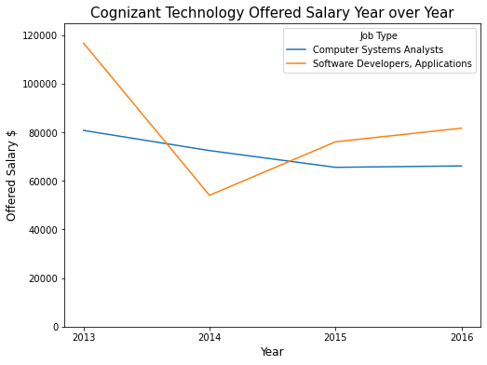
Cognizant Technology
h1B Applications Requested
Salaries Offered

